Slide 1
Teaching RDA
Train-the-trainer course for
RDA: Resource Description and Access
Presented by the National Library of Australia
September – November 2012

Slide 2
Module 5 Key differences from AACR2
Recording Data

Slide 3
Learning Outcomes
Differences between AACR2 and RDA:
Transcription changes
ISBD changes
Changes from GMD to Content, Media and Carrier types
Notes:
In this module, we’re going to look at the key areas in which RDA differs from AACR2, in terms of the data we actually record.
-Transcription changes
-ISBD changes
-GMD

Slide 4
Recording and transcribing
Language and Script
Abbreviations
Inaccuracies
Supplied title information
Marks of punctuation
Rule of three
Notes:
The recommended readings included Statement of International Cataloguing Principles (ICP). A number of changes to the way we record information in key elements are aimed at supporting these principles. They include convenience to the user, representation, common usage, accuracy, consistency and standardisation, sufficiency and necessity.
We are now going to look at examples that highlights some of these changes.
This exercise is derived from Adam Schiff’s (University of Washington) detailed set of examples outlining these changes. [A link to his document is in the back of your workbook]

Slide 5
Abbreviations
Notes:
A key aim in RDA is to reduce, wherever possible the use of abbreviations. When transcribing data, abbreviations should only be included in catalogue data when and as they appear in the source the data is being transcribed from. When recording data, abbreviations should generally be avoided.
For example, in these edition statements, edition terms are to be transcribed as they are on the resource. If they are abbreviated on the resource, as in the last example, then they are abbreviated in the catalogue data, but if they are spelled out on the resource, they will not be abbreviated as they would have been in AACR2.
Punctuation
Note the last example on the slide and the two full stops; This is an ISBD change.
The revised ISBD fixed up a small inconsistency that had crept into ISBD with regard to the full stops that separated elements. It is basically that full stops which separate elements should always be recorded, regardless of any ending punctuation in the data contained in the previous element.
Previously ISBD contained an instruction that if the data in an element ended with a full stop or mark of omission, the full stop that preceded the next element could be omitted. But this was in contradiction with the overall principle that punctuation between elements should always be included, even if it results in double punctuation. In reality of course, most of our systems are providing the element separation (eg through means of a delimiter) so we will generally not see these double full stops.

Slide 6
Abbreviations
Notes:
And state and country names and the word “Department” will now be spelt out. The “Department” example applies in corporate body access points as well.
Note: In these slides, the 260 has been used. However, there is a new MARC field, the 264 that we will be using instead of the 260, which was introduced after these slides we borrowed from Adam Schiff were produced. We’ll explain about the 264 in the next module.

Slide 7
Abbreviations
Notes:
Latin abbreviations that were used in AACR2 to indicate incorrect, omitted, or missing data, were seen to be largely meaningless to most people, so these have been eliminated where possible.
In this example, instead of the Latin abbreviation, all four authors are listed in the statement of responsibility.

Slide 8
Abbreviations
Notes:
“S.l.” becomes “place of publication not identified”
“s.n.” becomes “publisher not identified”
NOTE: There is an equivalent for dates – “date of publication not identified” - which can be used in rare cases when no date can be found on the item or ascertained from elsewhere. However, RDA considers date to be a key piece of data, and strongly encourages that a date be recorded, wherever possible, even if you have to give an estimation. An estimated date, even if it is date range, is better than no date at all.

Slide 9
Abbreviations
Notes:
Another access point example where RDA’s reduction in the use of abbreviations changes things is with Bible access points, where O.T and N.T. are now spelt out.
However, another change, driven separately by the desire to simplify Bible access points, means that the Testament will only be included in a Bible access point when the resource is the WHOLE of the stipulated Testament. Individual books will be recorded directly under “Bible” rather than as a subset of one of the Testaments.

Slide 10
Inaccuracies
Notes:
We also no longer use Latin abbreviations to indicate typographical errors on title pages. In order to represent a resource as it represents itself, RDA instructs us to leave inaccuracies in titles as they appear and correct them using a variant title entry. This is instead of using the Latin abbreviations ,”Sic” or “i.e”.
The only exception to this instruction, is for titles of serials or integrating resources, where you do correct the errors. And this makes sense, because the error is unlikely to appear on every issue, and when describing a serial, you are describing the whole resource, not just one part of it.

Slide 11
Supplied title information
Notes:
When recording data in elements that are transcribed, such as the title element, RDA discourages adding additional information that is NOT present anywhere on the resource, and has therefore been supplied by the cataloguer. Of course, if you are cataloguing something that doesn’t have a title at all, like a picture, RDA still has instructions for devising titles.

Slide 12
Marks of punctuation
Notes:
In AACR2, if the punctuation marks “...” or “[ ]” appeared in the title of a resource, they had to be changed to “—“ and “( )” so that they weren’t confused with ISBD punctuation. Because RDA does not assume the use of ISBD, it now asks us to transcribe these as they appear on the item without changing them.

Slide 13
Parallel titles
Source: Changes from AACR2 to RDA: A comparison of examples / Adam L. Schiff
Notes:
Instructions for titles are in general unchanged from AACR2.
But the provisions for parallel titles have changed a bit. They are a non-core element now, so you are not required to record them. However, if you do record them, you would record all of them, instead of the specified number prescribed by AACR2 (depending on which level you were cataloguing at).
Also, the source of information for parallel titles has now been expanded to include the whole resource, not just the preferred source.
This is an example which illustrates how this would look in a MARC record.
13

Slide 14
Rule of Three
Notes:
AACR2 cataloguers will be familiar with the “Rule of three” instructions, which was an arbitrary cut-off set by AACR2 when recording information about resources with large numbers of people and corporate bodies responsible for its creation. RDA essentially removes this arbitrary cut-off and instead all people, families or corporate bodies listed in the resource as having a relationship to it can and in many cases should be listed in statements of responsibility and given access to in access points. This is of course a simplistic explanation of how “rule of three” has changed, and it certainly doesn’t mean you are required to record all of them. We will go into the detail of how it works in practical terms when we look in detail at specific instructions later.
But here are just a couple of examples of what this change might look like. Firstly, if you record them all,

Slide 15
Rule of Three
Notes:
and secondly, if you choose to follow the optional omission (remembering that we don’t use Latin abbreviations any more)
Abbreviations indicating missing or omitted data have now been replaced by natural language phrases. Eg.
“et al...” becomes “and others” or “and 3 (or 4, ... etc) others”

Slide 16
Example
020 $a 9780980458695
245 00 $a Infectious diseases :$b a clinical approach/$c edited by Allen Yung [and five others].
250 $a Third edition.
264 1 $a Melbourne :$b IP Communications, $c 2010.
300 $a xxix, 698 pages :$b illustrations ;$c 26 cm.
$a
336 $a
337 $a
$a
500 $a Includes biographical references.
0 $a Communicable diseases
700 1 $a Yung, Allen P. $e editor.
Notes:
What does this mean in reality. Let’s look at an example.
There are more than 3 authors, but “et al” is gone now, replaced by “and five others”. This applies the optional omission at 2.4.1.5, which allows you to omit all but the first. However, in following the main instruction you would include all the authors.
There are some abbreviations that can be spelt out
250 – This phrase is spelt out in the item, so it is not abbreviated in the record.
300 – 698 p. Becomes 698 pages. However cm stays as cm – it’s not an abbreviation but a metric symbol see RDA 3.5.1.4
[we are going to look at the 336-338 fields next]

Slide 17
Exercise
Notes:
Exercise: Transcription elements

Slide 18
Examples
Where to find more examples
Library of Congress Test Records
http://www.loc.gov/catdir/cpso/RDAtest/rdatestrecords.html
North Carolina State University
https://staff.lib.ncsu.edu/confluence/display/MNC/RDA
RDA Toolkit
http://www.rdatoolkit.org/examples/MARC
Notes:
Where to find more examples
These records were collated as part of testing, we have not made any attempt to confirm that the records actually conform to RDA or that the marc structure is valid [where appropriate]. The best source for information about RDA instructions is RDA itself. Be cautious about forming conclusions about RDA provisions based solely on these test records

Slide 19
Content, Media, Carrier types
What is the GMD for:
A map on CD-ROM?
A movie?
Printed text?

Slide 20
Content type
RDA 6.9
Content type
computer dataset
cartographic image
tactile text
notated movement
notated music
MARC 336
Notes:
Content type:
Content type is the form of communication in which the content of the resource is expressed and the human sense through which it is intended to be perceived.
Where – RDA 6.9
Recorded in Marc field – 336 (repeatable)
It is a core element
The instruction at 6.9 allows you to use as many terms as appropriate for the resource.
The alternative instruction allows you just to record the predominant content type.
National Library Policy - do not to apply the alternative.
Group exercise: [note to presenter: you may have at hand a number of items to demonstrate this exercise]

Slide 21
Media type
RDA 3.2
Media type
computer
unmediated
audio
microform
projected
MARC 337
Notes:
Media type is a category of the general type of device required to view, play, run, etc., the content of a resource.
Where – RDA 3.2
Recorded in Marc field – 337 (repeatable)
It is not a core element – however is mandatory for NLA
The instruction at 3.2 allows you to use as many terms as appropriate for the resource.
The alternative instruction allows you just to record the predominant content type.
National Library Policy - do not to apply the alternative.
Group exercise: [note to presenter: you may have at hand a number of items to demonstrate this exercise]
Use the list of terms at 3.2 and find the media type for various material types; suggestions as previous exercise:

Slide 22
Carrier type
RDA 3.3
Carrier type
computer carriers
unmediated carriers
audio carriers
projected image carriers
microform carriers
MARC 338
Notes:
Carrier type is a category reflecting the format of the storage medium and housing of a carrier in combination with the type of intermediation device required to view, play, run, etc., the content of a resource.
Where – RDA 3.3
Recorded in Marc field – 338 (repeatable)
It is a core element
The instruction at 3.3 allows you to use as many terms as appropriate for the resource.
The alternative instruction allows you just to record the predominant content type.
National Library Policy - do not to apply the alternative.
Group exercise: [note to presenter: you may have at hand a number of items to demonstrate this exercise]
Use the list of terms at 3.3 and find the media type for various material types; suggestions as previous exercise:

Slide 23
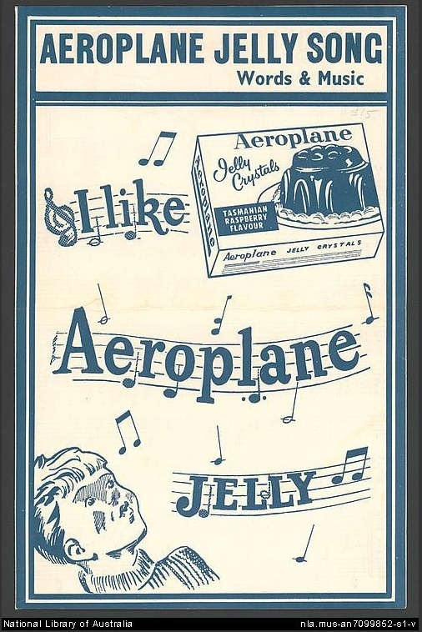
Content, Media, Carrier types
245 1 0 $a Aeroplane jelly song
336 # # $a notated music $2 rdacontent
337 # # $a unmediated $2 rdamedia
338 # # $a volume $2 rdacarrier
Notes:
Content, media and carrier exercise.
Question 1 – do as a group

Slide 24
Exercise
Notes:
Content media carrier type exercise

Slide 25
Summary
Transcription changes
ISBD changes
Content, Media and Carrier types

