Slide 1
Teaching RDA
Train-the-trainer course for
RDA: Resource Description and Access
Presented by the National Library of Australia
September – November 2012

Slide 2
NLA Workflows in the RDA Toolkit

Slide 3
Learning Outcomes
Create a personal profile
Become familiar with the RDA Toolkit interactive tools
Create saved searches and bookmarks
Create workflows and maps
Notes:
In this module we will look at some of the user created content in the RDA Toolkit
You will need a personal profile to make use of these advanced features, so you will also learn about creating personal profiles.

Slide 4
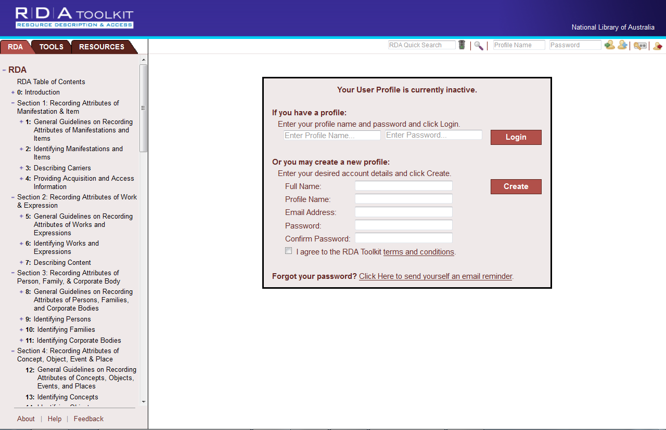
Creating a profile
Screen image from the RDA Toolkit (www.rdatoolkit.org) used by permission of the Co-Publishers for RDA (American Library Association, Canadian Library Association, and CILIP: Chartered Institute of Library and Information Professionals)
Notes:
It is not necessary have a personal profile to search, navigate and view the documents loaded to the toolkit. However, to make use of the features we are about to demonstrate, you will need a personal profile.
When you first open up the Toolkit, you would first sign into your institution’s subscription. (If you have IP authentication you will not need to do this, you will already be in your institution’s subscription)
You can also create your own personal profile. It is very easy to do; just click on the “person icon” with the blue plus symbol. The Login/create profile box is displayed.
The “profile name” is effectively your “user name” and is what you will use to login to your profile later, so make sure it’s one you can remember easily. The reason you are asked for your email address is so that if you later forget your password, you can ask the Toolkit to email it to you.
Once you have a profile set up, you can simply log in to it anytime by typing the “Profile name” and password in the boxes provided on the User menu.
Note: This box will also come up if at any time you try to use advanced functions that require a log-in, and you haven’t logged in. That’s why you are given the option of simply logging in as if you already have a profile.

Slide 5
Screen image from the RDA Toolkit (www.rdatoolkit.org) used by permission of the Co-Publishers for RDA (American Library Association, Canadian Library Association, and CILIP: Chartered Institute of Library and Information Professionals)
Notes:
Once you’re logged in, the Full name (Note: not the user name) you specified should be appearing in the blue section at the top of the screen, above the institutional name. So now let’s look at the key advanced features we can now access.

Slide 6
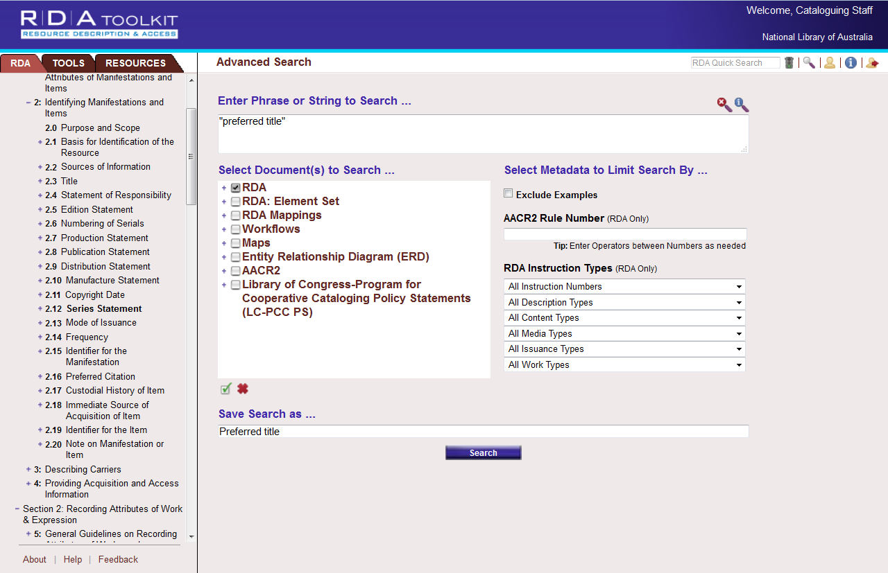
Screen image from the RDA Toolkit (www.rdatoolkit.org) used by permission of the Co-Publishers for RDA (American Library Association, Canadian Library Association, and CILIP: Chartered Institute of Library and Information Professionals)
Notes:
Firstly, now that you have a personal profile, you can save searches. You do this in the “Advanced search” screen, by entering a name for your search in the “Save search as...” box at the bottom of the screen, before you execute your search. I will show you in a minute how you get back to these saved searches.

Slide 7
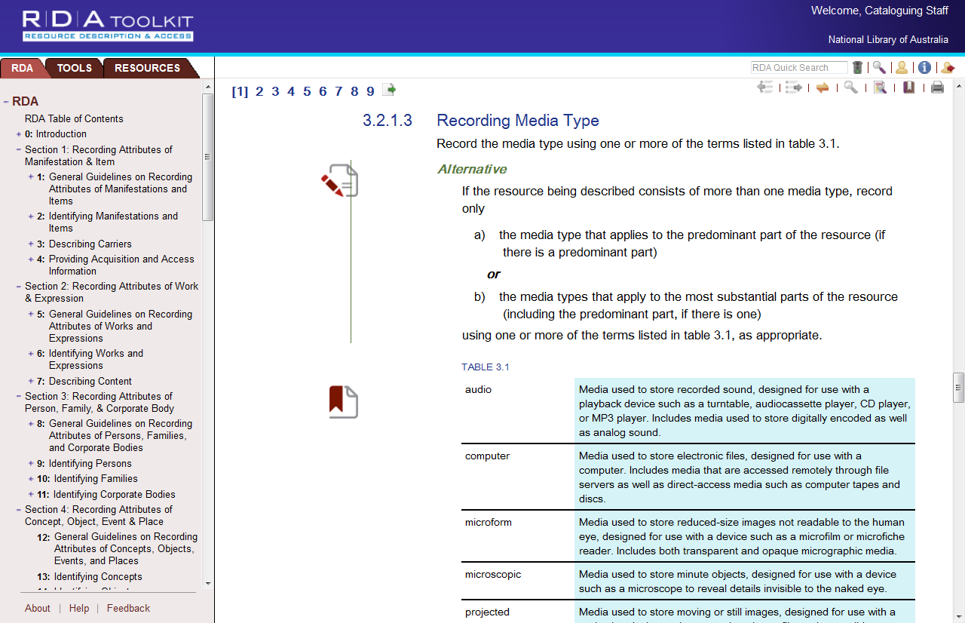
Screen image from the RDA Toolkit (www.rdatoolkit.org) used by permission of the Co-Publishers for RDA (American Library Association, Canadian Library Association, and CILIP: Chartered Institute of Library and Information Professionals)
Notes:
Bookmarks
Another advanced feature is bookmarks. On this page, you can see some little symbols that look like a piece of paper. These are “Bookmarks”. When logged in to your personal profile, if you find a section you want to be able to get back to later, you can bookmark it, using the “bookmark” link in the Document menu. You’ll notice one of them has a pencil, and the other has a little ribbon.
You can either use bookmarks as just a place-marker, to make it easy to find this spot later on. These are the “ribbon” bookmarks
Or you can use bookmarks to write “margin notes” for yourself. These bookmarks have a pencil on them, to indicate that there is text associated with this bookmark. If you hover your mouse over this type of bookmark, the textual note will appear.
So let’s look at how to create and use these bookmarks. First, you need to find the section of RDA you want to bookmark. For the purposes of this exercise, let’s go to 2.12 Series Statement...

Slide 8
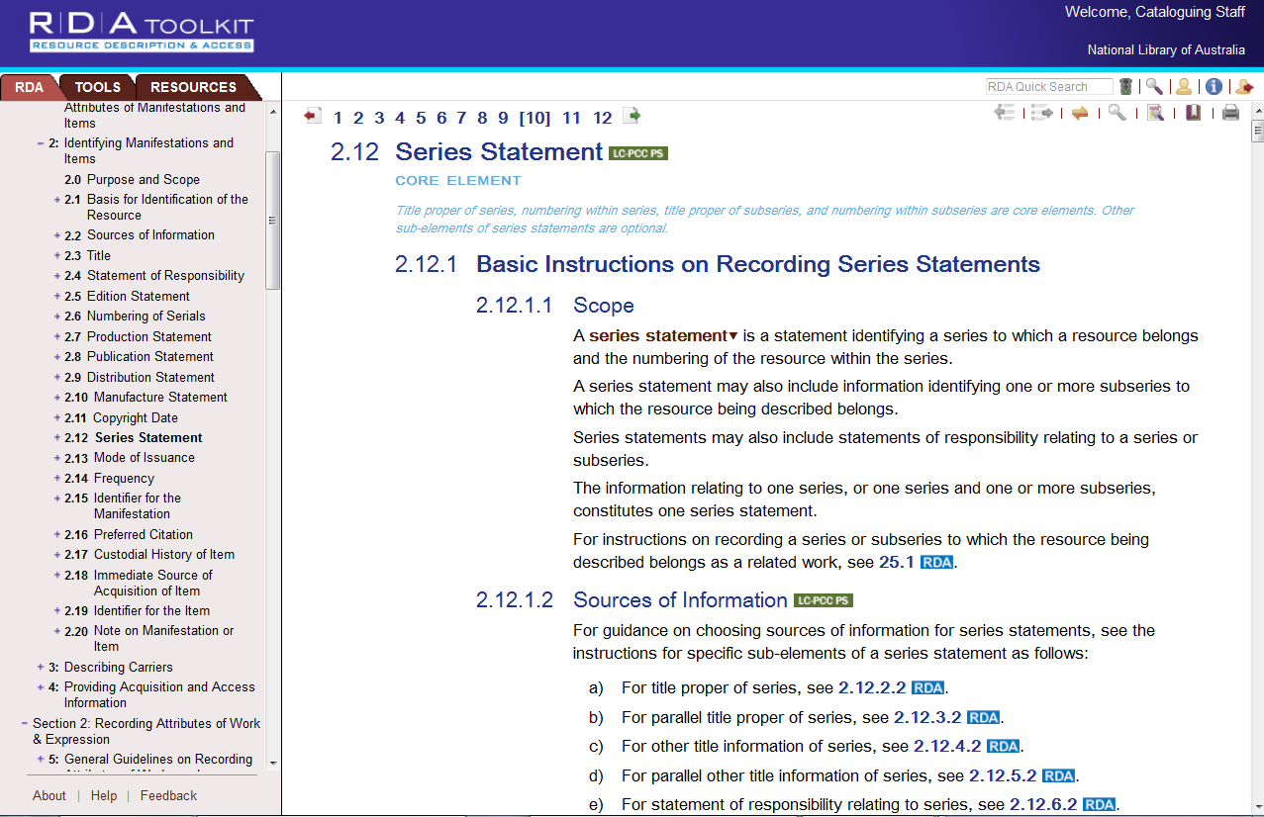
Screen image from the RDA Toolkit (www.rdatoolkit.org) used by permission of the Co-Publishers for RDA (American Library Association, Canadian Library Association, and CILIP: Chartered Institute of Library and Information Professionals)
Notes:
Click on the “Bookmark” icon in the Document menu

Slide 9
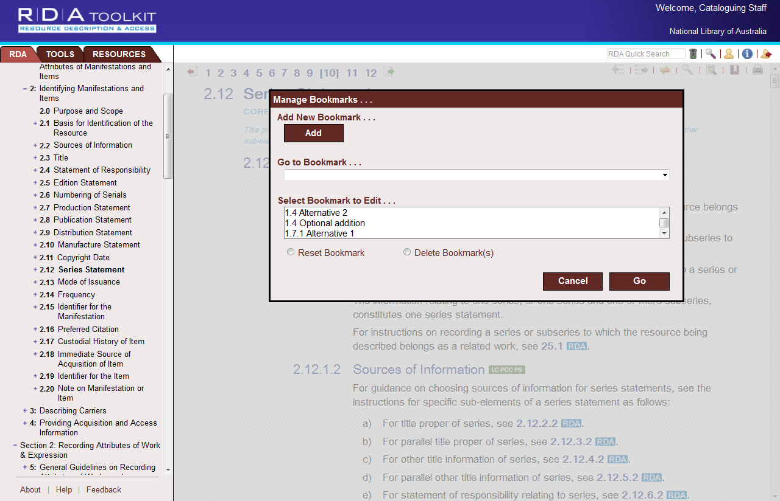
Screen image from the RDA Toolkit (www.rdatoolkit.org) used by permission of the Co-Publishers for RDA (American Library Association, Canadian Library Association, and CILIP: Chartered Institute of Library and Information Professionals)
Notes:
You’ll get a “Manage bookmarks” window, which allows you to either add a new bookmark, go to an existing bookmark, or select a bookmark to edit.
Firstly, to create the bookmark, click on the “Add” button

Slide 10
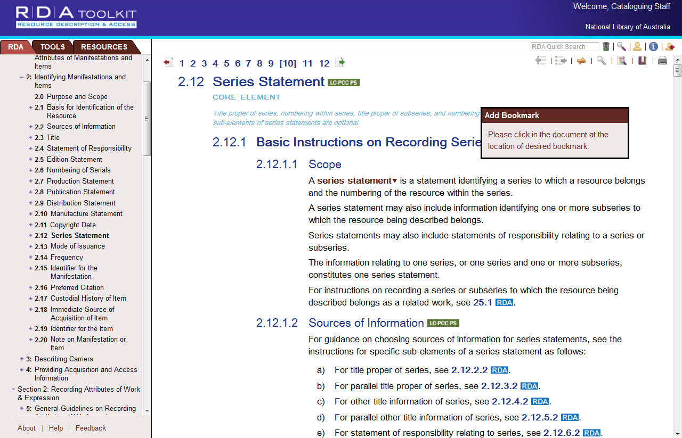
Screen image from the RDA Toolkit (www.rdatoolkit.org) used by permission of the Co-Publishers for RDA (American Library Association, Canadian Library Association, and CILIP: Chartered Institute of Library and Information Professionals)
Notes:
It takes you back to the document pane, and asks you to click in the document at the spot where you want the bookmark to be.
Make sure you click in the text area and not over in the very left margin. This area is outside of the text frame, so it will not work.

Slide 11
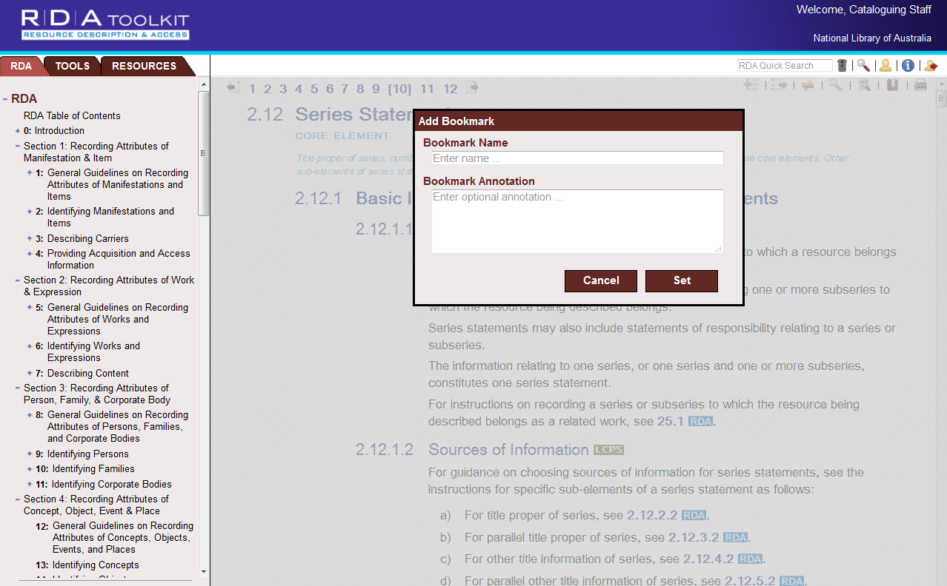
Screen image from the RDA Toolkit (www.rdatoolkit.org) used by permission of the Co-Publishers for RDA (American Library Association, Canadian Library Association, and CILIP: Chartered Institute of Library and Information Professionals)
Notes:
When you’ve selected the spot, it then gives you a box to fill in with the name of the bookmark (always fill this in) and any annotation you might want to put with it. When you’re finished, click Set.

Slide 12
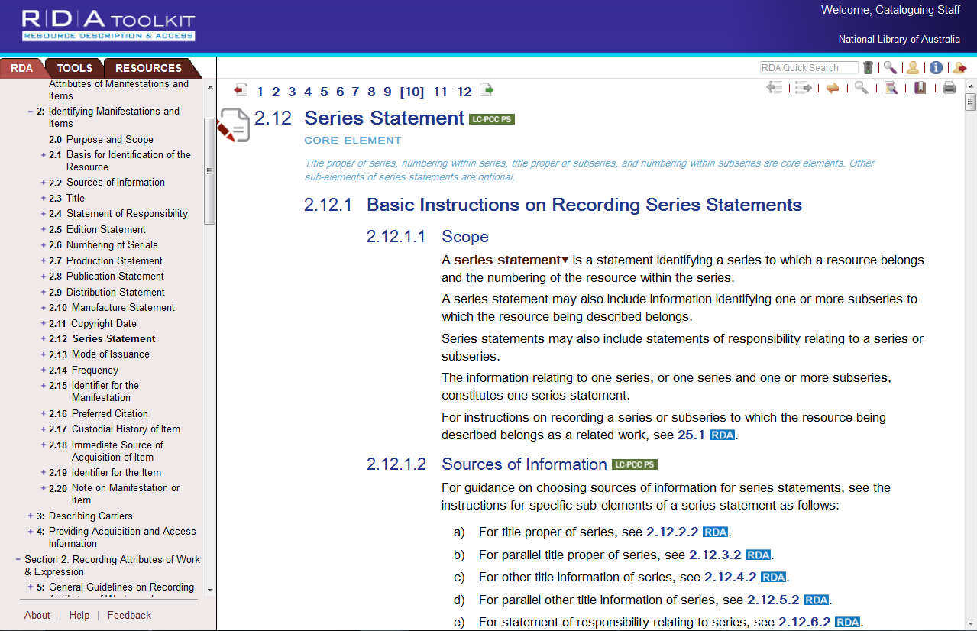
Screen image from the RDA Toolkit (www.rdatoolkit.org) used by permission of the Co-Publishers for RDA (American Library Association, Canadian Library Association, and CILIP: Chartered Institute of Library and Information Professionals)
Notes:
And there is your bookmark. If you hover over it, any text you entered in the “annotation” area will pop up.

Slide 13
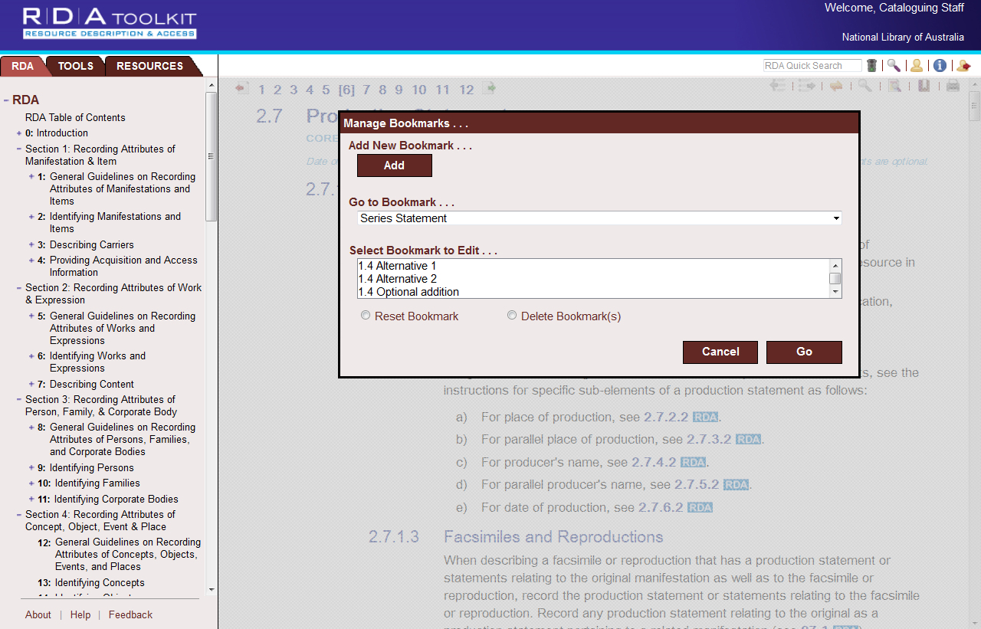
Screen image from the RDA Toolkit (www.rdatoolkit.org) used by permission of the Co-Publishers for RDA (American Library Association, Canadian Library Association, and CILIP: Chartered Institute of Library and Information Professionals)
Notes:
And if you are somewhere else in RDA and want to find your way back to this spot, simply click on Bookmarks again, and from this window, choose “Series statement” from the list under “Go to Bookmark...” and click “Go”
If you want to either move or delete the bookmark, select it from the list under “Select bookmark to edit...” and choose either “Reset” or “Delete Bookmark(s)”
NOTE: If you wish to change the title of your bookmark, or amend the note you have attached to it, you can’t do this at present. You need to delete the bookmark and re-enter it with the desired title and text.
This window can be a bit clunky to use to find your bookmarks. The “edit” box in particular, is not a drop down box, and it is very narrow, so if you have a lot of bookmarks, scrolling through this list is not very easy. So I’m going to show you another way to get to the bookmarks you’ve already created.
Manage your profile
Up in the user menu, click on the yellow person icon, which is “My profile”

Slide 14
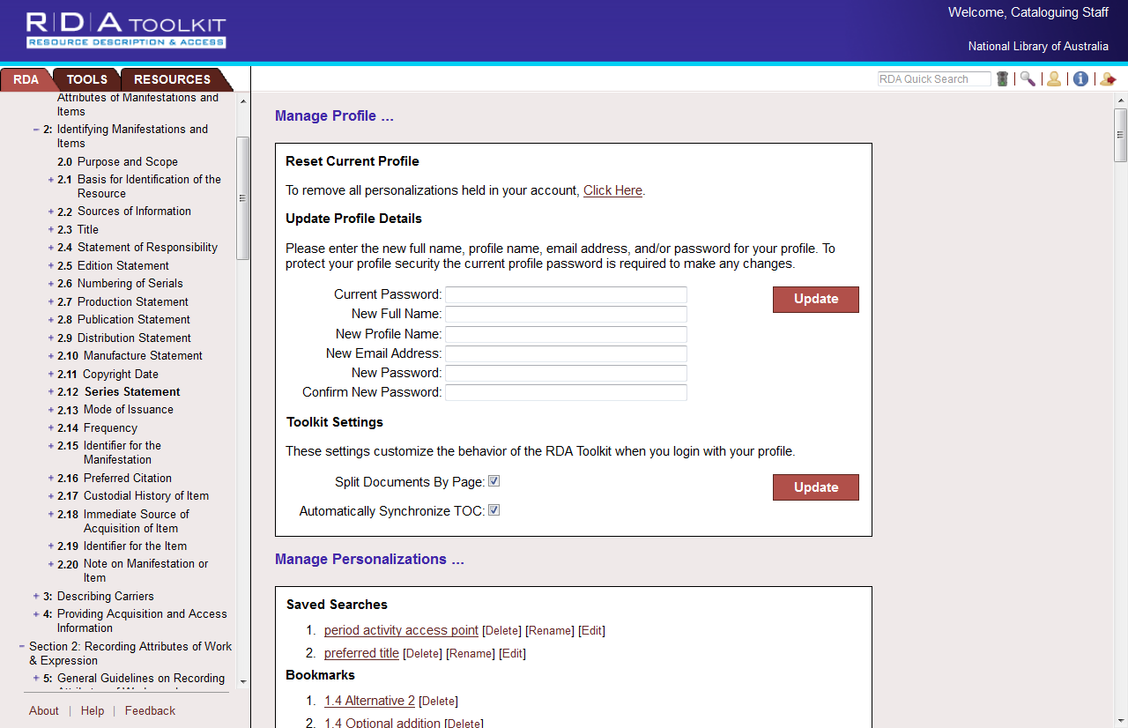
Screen image from the RDA Toolkit (www.rdatoolkit.org) used by permission of the Co-Publishers for RDA (American Library Association, Canadian Library Association, and CILIP: Chartered Institute of Library and Information Professionals)
Notes:
Manage your profile
Alternatively, you can access all your saved searches, bookmarks and workflows by going to “My profile” (Yellow person . Here is where you can do things like change your password, and manage Toolkit settings. (For example, you can turn off automatic synching of the TOC)
It is much easier to access your bookmarks and workflows from here, because it is a much bigger screen that is easier to move around than the one we just looked at. All the functions to Rename, edit, delete are available here too.

Slide 15
Exercise
Notes:
Saved searches and bookmarks exercise

Slide 16
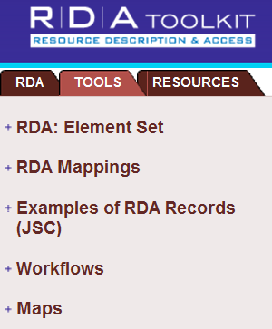
Workflows
Like cataloguing procedures, cheat sheets
Found in “Tools” in the Toolkit
Store workflows, documentation for personal, institutional or global use without having to leave the Toolkit
Useful for transition to RDA and navigation to correct instructions, guidance on NLA policies
Shared as global, local my workflows
Notes:
Workflows/Maps
Workflows are like cataloguing procedures that enable users to describe cataloguing processes within the Toolkit. The workflows are found under the TOOLS tab in the Toolkit.
The Workflow tool provides a place to store workflow documentation for personal, institutional or global use without having to leave the Toolkit.
Workflows will be useful for staff when transitioning to RDA to get them used to using the Toolkit and navigating to the correct instructions. It will also assist in guiding your staff into RDA for specialised cataloguing or to provide guidance on local policies.
Global workflows are visible to the person who created them using the My Workflows link in the left navigation tree and are also visible to all users of RDA Toolkit.
Local workflows are visible to the person who created them as well as visible to the other users on the same Institutional account as the user who created the workflow.
My workflows are workflows created under a personal login. They include any global or local workflows created and shared via that profile, as well as any non-shared workflows.
More on this later

Slide 17
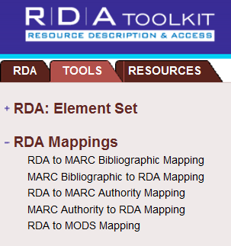
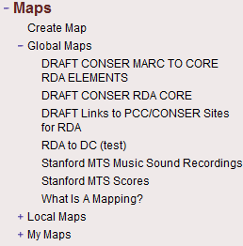
Maps
Show correlation between data sets e.g. Toolkit mappings between RDA instructions & MARC encoding
Users can create own
Useful in navigating RDA in relation to standards we are familiar with e.g. MARC
Notes:
Maps
Maps are used to show correlation between one set of data and another. For example the Toolkit has set up Mappings between RDA instructions and MARC encoding. Users can also create their own maps. Maps are usually in a table view that show correlations between two standards. They will be useful in helping us navigate RDA in relation to standards we are more familiar with.
The process for creating Workflows and Maps are almost identical and you may find there is overlap between two in the resulting documents. For this demonstration we are going to concentrate on creating a workflow.

Slide 18
Examples
Workflows
LC staff: Adding attributes for persons with surnames and given names. (Simple)
LC Staff: Simple book workflow (Complex)
Maps
Draft CONSER RDA Core
Stanford MTS Score
Notes:
Let’s look at some examples [call these up in Toolkit]

Slide 19
Creating a workflow/map
Notes:
Creating workflows
The process for creating Workflows and Maps are almost identical and you may find there is overlap between two in the resulting documents. For this demonstration we are going to concentrate on creating a workflow.
Go into the TOOLS tab and click on workflows.
Click on Create workflow to open the Create Workflow dialogue box (shown above)
When you click on “Create Workflow” or “Create Map” you will get this metadata screen, which you need to fill in with information about the workflow.
The only required field is the Name your Workflow but you can add information in the other fields such as author, version or category i.e. whether it is a workflow, map, training material or local policy.
You should also select the appropriate Licence. User created content raises copyright and fair use concerns so a Licence is needed to protect the content rights of end users, our institutions and the Toolkit publishers. See the Help menu for more information on Licences which is located at the bottom of the Toolkit page.
While shared workflows can be helpful and informative they can also a bit overwhelming due to the number and the variations. (Open and demonstrate various workflows within the Global workflows list.) So you can already see how it can difficult to navigate through a large list and select one you might want to use.
Therefore, it is a good idea to give your workflows meaningful names so they all appear together in the list, and also to give as much useful information in this metadata screen as possible.
Click on create new, and then Go. A blank document will appear in the HTML editor.
Copying an existing workflow
Alternatively, you can copy an existing workflow to use as a guide and edit it to suit your institutions needs.
Follow the instructions above and click on Copy existing. Choose a globally or locally shared workflow to copy from the list. Click on Go.

Slide 20
Metadata Examples
Archival collections
Poor metadata
Pan-Canadian Working Group
Eg of best practice
Notes:
Examples from “global” workflows of good and bad practice:
Archival collections (bad)
Pan-Canadian working group – Book (good)

Slide 21
Demonstration
Notes:
Demonstrate HTML editor in Tookit, in particular:
Menu bar
Special characters icon
Paste from Word
Linking tools (RDA text, elsewhere in Toolkit, external links)
Selecting the share mode.

Slide 22
Demonstration
Share Mode
Past from Word
Linking tool
Insert Special characters (for diacritics)
Notes:
[Best to demonstrate live. This slide just a reminder of what to demonstrate and where to find it]
Menu bar
Special characters icon
Paste from Word
Linking tools (RDA text, elsewhere in Toolkit, external links)
Selecting the share mode.

Slide 23
Demonstration
Notes:
My Profile – Manage Personalisations – Workflows – Metadata [Next to the document title]
You can also go to the “Manage Profile” window in the Toolkit to delete, edit and change the sharing mode of your workflow. Here you can also make changes to the blue Metadata screen we saw when creating the workflow. This is the only place you can do this.
Only the creator of the workflow can do these things.

Slide 24
Exercise
Notes:
Workflows exercise

