Slide 1
Web transaction log analysis
and its role in understanding catalogue use
Bradley Cummings
National Library of Australia

Slide 2
About the project
The options
About website transaction logs
Implementing transaction log analysis at the NLA
Examples of results
Pros and cons
What next?

Slide 3
static-71-162-11-23.pitbpa.fios.verizon.net - - [07/Sep/2010:09:59:59 +1000] "GET /Record/305182/Details? HTTP/1.0" 200 22049 "-" "Lynx/2.8.7rel.1 libwww-FM/2.14FM SSL-MM/1.4.1 OpenSSL/0.9.8k” 219-89-123-138.adsl.xtra.co.nz - - [07/Sep/2010:09:59:59 +1000] "GET /fcgi-bin/nlathumb.fcgi?id=1889025&mode=thumb HTTP/1.1" 200 6132 http://catalogue.nla.gov.au/Search/Home?filter%5B%5D=pi%3Anla.pic*&type=all&lookfor=taranaki&x=21&y=7" Mozilla/4.0 (compatible; MSIE 8.0; Windows NT 5.1; Trident/4.0; GTB6.5; .NET CLR 2.0.50727; .NET CLR 3.0.04506.30; .NET CLR 1.1.4322; .NET CLR 3.0.4506.2152; .NET CLR 3.5.30729)“ wsce2.curtin.edu.au - - [07/Sep/2010:10:00:00 +1000] "GET /images/NLA_ts.gif HTTP/1.1" 304 - http://catalogue.nla.gov.au/Record/3533807 "Mozilla/4.0 (compatible; MSIE 7.0; Windows NT 5.1; .NET CLR 2.0.50727; .NET CLR 1.1.4322)“ host-41.239.141.43.tedata.net - - [07/Sep/2010:10:00:00 +1000] "GET /images/tabs_hover_bg.jpg HTTP/1.1" 200 328 "http://translate.googleusercontent.com/translate_c?hl=ar&langpair=en%7Car&u=http://catalogue.nla.gov.au/Record/1 04145%3Flookfor%3Dsubject:%2522Economics%2520%2520Textbooks.%2522%26offset%3D16%26max%3D69&rurl=translate.google.com.eg&usg=ALkJrhh4ADGqTzp9NXu3W5jzNHQOtIsUcg" "Mozilla/4.0 (compatible; MSIE 8.0; Windows NT 6.1; WOW64; Trident/4.0; GTB6.5; SLCC2; .NET CLR 2.0.50727; .NET CLR 3.5.30729; .NET CLR 3.0.30729; Media Center PC 6.0)“ 219-89-123-138.adsl.xtra.co.nz - - [07/Sep/2010:09:59:59 +1000] "GET /fcgi-bin/requestable.fcgi?callback=showAvailability&bibids=896755,2884555,1689004,891094,2415663,1320231,440269,747394,1362112,2413409,2379460,1313803,2412983,2398516,1204483,2319971,2407821,1889025,2412944,896449 HTTP/1.1" 200 295 http://catalogue.nla.gov.au/Search/Home?filter%5B%5D=pi%3Anla.pic*&type=all&lookfor=taranaki&x=21&y=7 "Mozilla/4.0 (compatible; MSIE 8.0; Windows NT 5.1; Trident/4.0; GTB6.5; .NET CLR 2.0.50727; .NET CLR 3.0.04506.30; .NET CLR 1.1.4322; .NET CLR 3.0.4506.2152; .NET CLR 3.5.30729)“ wsce2.curtin.edu.au - - [07/Sep/2010:10:00:00 +1000] "GET /images/body_header_bg.png HTTP/1.1" 304 - "http://catalogue.nla.gov.au/Record/3533807" "Mozilla/4.0 (compatible; MSIE 7.0; Windows NT 5.1; .NET CLR 2.0.50727; .NET CLR 1.1.4322)“ crawl-66-249-67-59.googlebot.com - - [07/Sep/2010:09:59:59 +1000] "GET /Record/4222548?lookfor=subject:%22Material%20culture.%22&offset=67&max=507 HTTP/1.1" 200 24771 "-" "Mozilla/5.0 (compatible; Googlebot/2.1; +http://www.google.com/bot.html)“

Slide 4
User address: pulteney-pix.border.net.adelaide.edu.au
Time stamp: [07/Sep/2010:10:00:00 +1000]
Request: "GET /Record/1159621 HTTP/1.0”
Result code: 200
Result size: 24374
Referring URL: "http://www.google.com.au/search?hl=en&
q=kangaroo+island+soil+conservation+board&meta="
User agent: "Mozilla/4.0 (compatible; MSIE 7.0; Windows NT 5.1;
SV1; .NET CLR 2.0.50727; InfoPath.2; .NET CLR 1.1.4322; .NET CLR 3.0.4506.2152; .NET CLR 3.5.30729)"

Slide 5
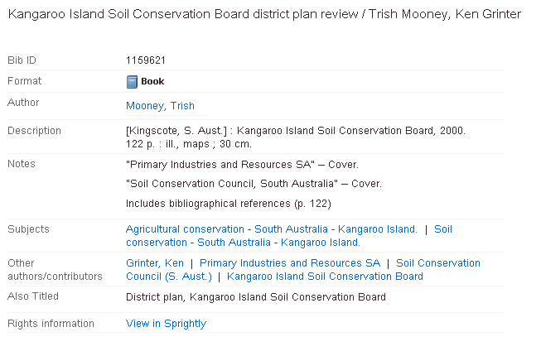

Slide 6
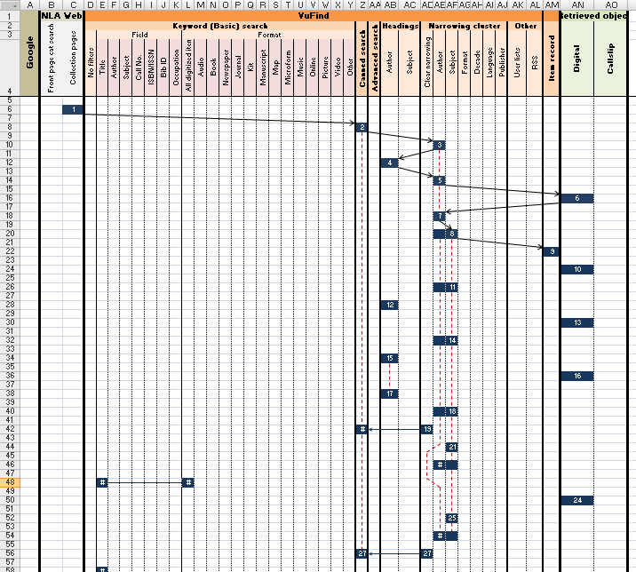

Slide 7
Problems analysing log data
Each transaction is logged (images, javascript, etc.)
IP addresses do not equate to people
A lot of activity is created by ‘robots’
No threading or continuity information
Durations are not logged

Slide 8
Not just one log file
Catalogue
NLA web
Content
User data

Slide 9
Not just one log file
Catalogue
NLA web
Content
User data
Clean
Clean
Clean
Clean

Slide 10
Not just one log file
Catalogue
NLA web
Content
User data
Clean
Clean
Clean
Clean
Combined data

Slide 11
Not just one log file
Catalogue
NLA web
Content
User data
Clean
Clean
Clean
Clean
Combined data
Combined sorted data

Slide 12
Analysis
Determine sessions by IP address and the time between transactions
Tag specific events
Scale session events with duration percentiles
Store in a database for re-use
Write scripts for specific queries

Slide 13
Query examples
How many unique sessions?
Result: 61999
How many single line sessions were referred from Google?
Result: 26519
How many sessions lasted longer than 30 minutes?
Result: 1184
Of those, how many were referred from Google?
Result: 11
Of the sessions longer than 30 minutes, how many included more than 20 Google referrals?
Result: 30
And, of those, how many viewed a digitized item?
Result: 28
... or clicked on a subject heading?
Result: 14
... or generated a callslip?
Result: 0
*

Slide 14
Pros and Cons
Can include activity beyond the scope of the catalogue alone.
Data can be queried for specific information.
Level of analytical detail far exceeds previous options or “canned” results.
Possible to include location specific data and limited user profiles.
Very large amount of data to process.
Data filtering and cleaning needs care.
Log data may be incomplete.
Requires PERL and SQL knowledge.

Slide 15
Next steps
Improve the ability to cope with larger data sets.
Improve and stabilize the scripts.
Prepare a suite of standard queries.
Develop an interface to ingest files (?)
Improve the threading/tracking of users within sessions.

