Slide 1
Ins and outs of discovery layers
The Deakin University Library experience
ACOC Seminar, 28th October 2011
Deakin University CRICOS code: 00113B

Slide 2
CRICOS provider code: 00113B
Notes:
Background info:
4 campuses
Melbourne Burwood Campus is biggest – 70% of on campus students enrolled there
Three regional campuses
29% of our students are off campus (never come into the library)
7 % of our students are international students – of these, 39% are Chinese and 11 % are Indian
Most of our students and staff are female
The largest age group cohort are young adults aged 20-24
11% are “mature age” – 40 +
The university is also focusing on research – so we are raising our research profile

Slide 3
CRICOS provider code: 00113B

Slide 4
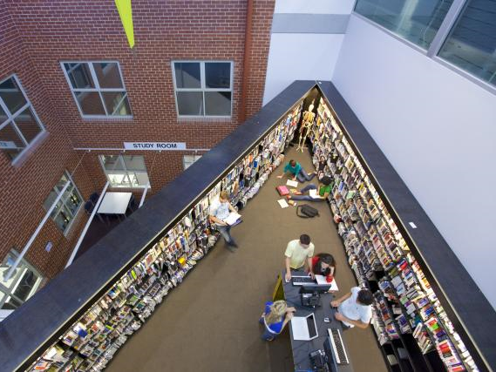
CRICOS provider code: 00113B

Slide 5
CRICOS provider code: 00113B

Slide 6
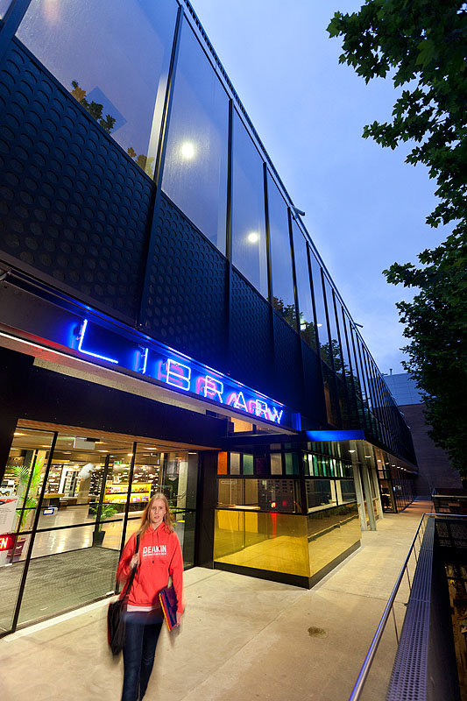
CRICOS provider code: 00113B

Slide 7
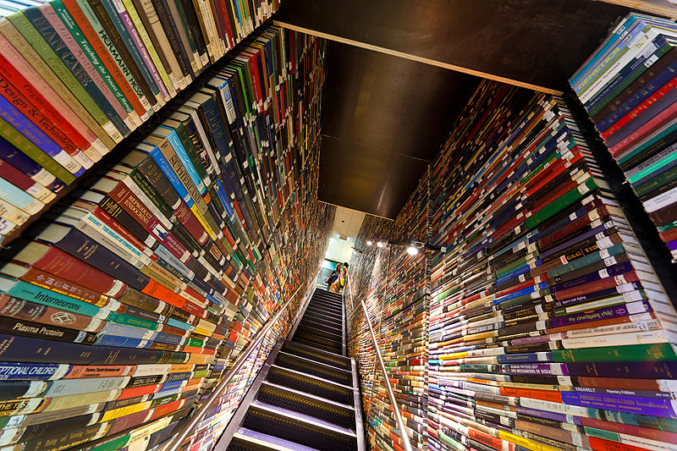
CRICOS provider code: 00113B

Slide 8
CRICOS provider code: 00113B

Slide 9
CRICOS provider code: 00113B

Slide 10
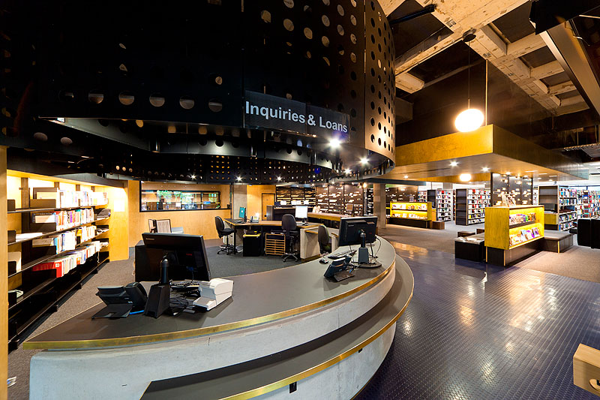
CRICOS provider code: 00113B

Slide 11
CRICOS provider code: 00113B

Slide 12
CRICOS provider code: 00113B

Slide 13
CRICOS provider code: 00113B

Slide 14
CRICOS provider code: 00113B
http://www.flickr.com/photos/22177648@N06/2137737248
Notes:
So what does all this mean for the Library in terms of the type of search interface we want to offer
Common to pigeon hole students and say
“undergraduates need an easy tool, and postgraduate users can cope with something more sophisticated”
There’s a big difference in skill levels between a first year undergrad and a third year undergrad
You might also have a new post grad student who hasn’t studied for years
The one thing they all have in common is they are all time pressured - they want simple, intuitive and they want it fast
Researchers also want comprehensive!

Slide 15
Mashup of EBSCO databases
Notes:
As part of our aim to provide an easy to use interface, we introduced Encore in 2009.
We called it ‘Quick search’
Features include:
simple keyword search
Usability testing indicated it was a simpler interface to use
Faceted display – all marc data is open and accessible and easy to filter down
Metadata – no big cleanups;
We wanted to improve the granularity of the Format facet
We have broken up the ‘a’ material type so it doesn’t just represent text material
Have separate material types for printed journals, e-journals, microforms, websites, CD-ROMs etc.
-----------------------
We’re currently running version 4.1 of Encore Synergy
Called Synergy because it includes articles in search results display
[click]
In Encore, Articles aren’t integrated into the search results – there is no single integrated index
Catalogue data is separate
Article results appear three records down from the top of the screen.
The articles that appear are a mashup of EBSCO databases
Quite an effective, neat search for an undergraduate who has been told to look for five articles on a topic

Slide 16
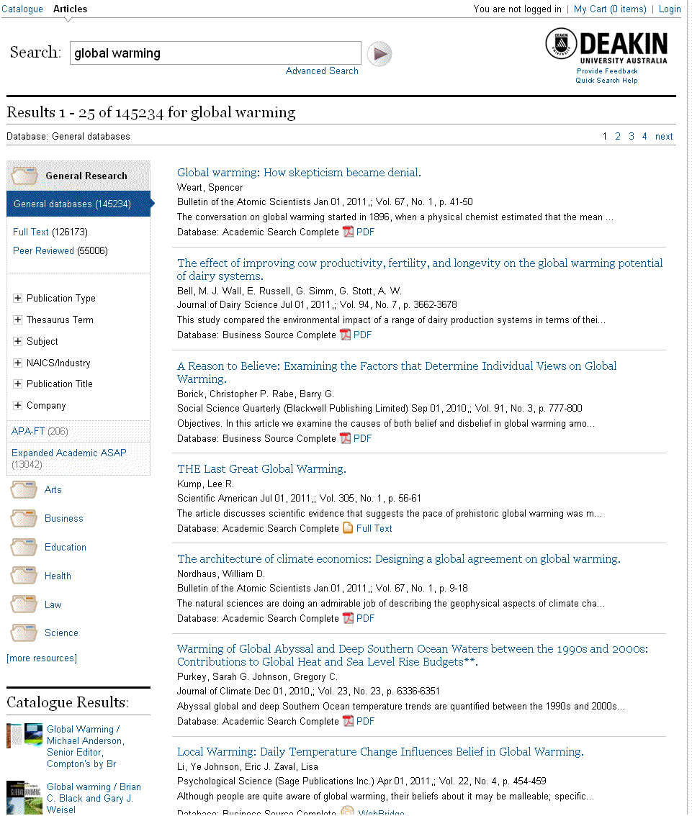
Subject groupings
Notes:
So, taking a closer look at the Articles display:
The latest version of Encore brought with it a number of enhancements:
For EBSCO and HeinOnline, the ability to limit up front via facets
Limits to the Full Text or Peer reviewed data is available up front
the number of databases we can offer via Encore is now unlimited
Databases are offered in Subject groupings
There is no interfiling of results, they are all listed separately

Slide 17
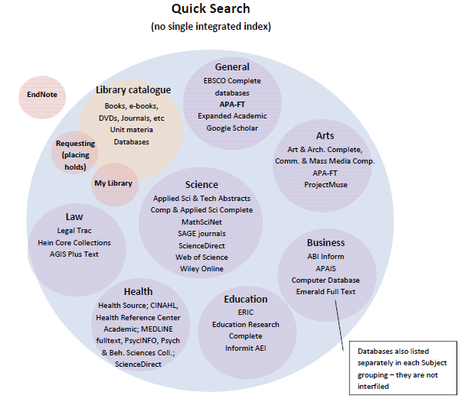
CRICOS provider code: 00113B
Notes:
- Here’s a visual representation of what you can get through Encore

Slide 18
Encore is “not even a discovery tool, although it is marketed as such –
it’s more of an enhanced, faceted library catalogue plus a federated search
tacked on.”
CRICOS provider code: 00113B
Notes:
Encore has copped a bit of flak from some librarians. One was quoted as saying “…”
Does this matter, as long as it is usable?
It may not be a complete discovery tool, but so what?

Slide 19
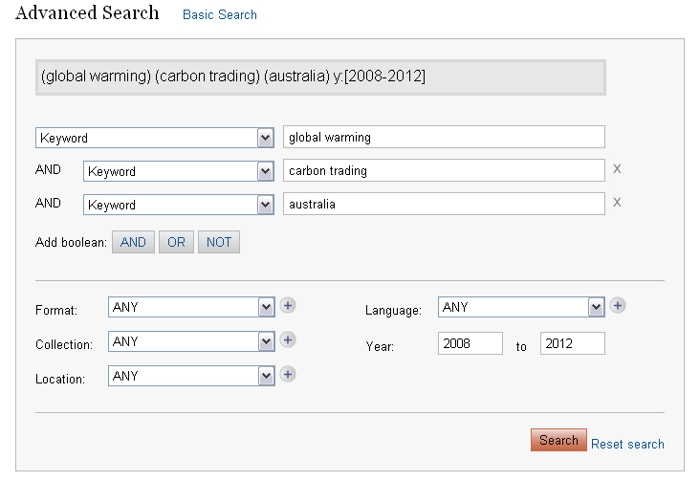
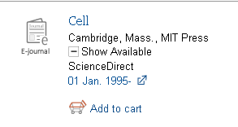
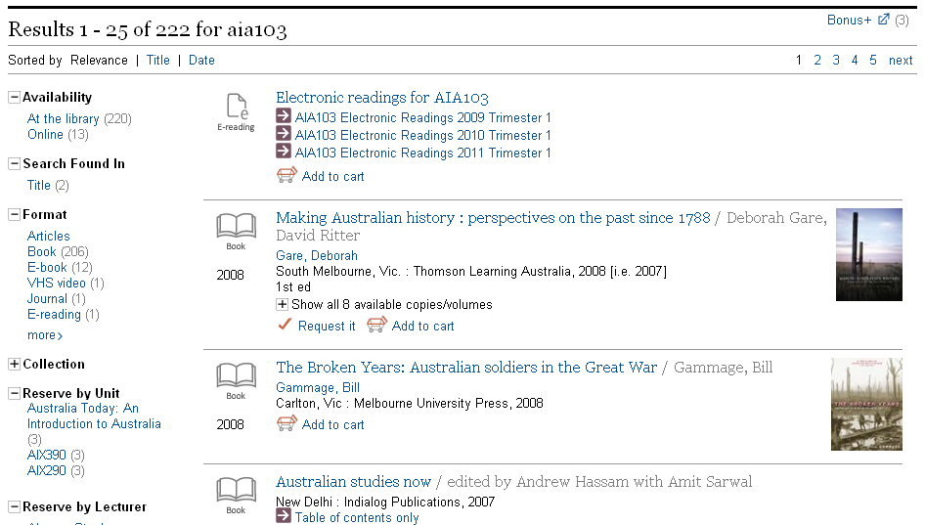
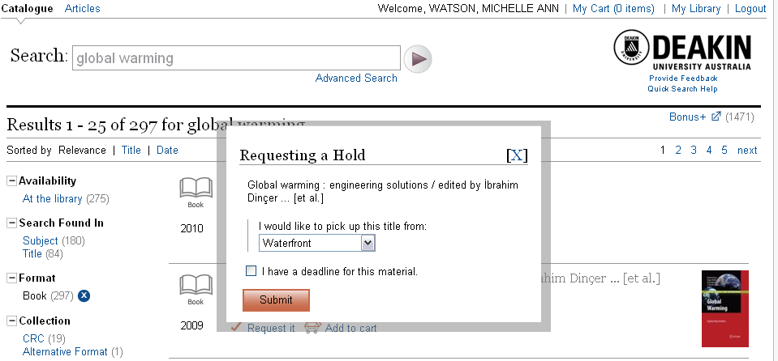
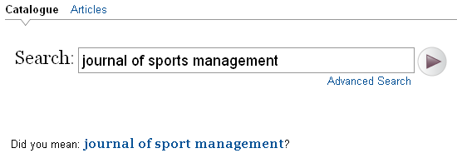
CRICOS provider code: 00113B
Notes:
The feedback we’re getting from Encore is that it’s easy to use
- It’s great for finding known book and journal titles
- You can easily find at least get some unit material
4.1 came with Advanced searching, so that’s a plus for those who want to do Boolean searching
Requesting is done entirely through Encore – so there’s no need to go to Classic catalogue to complete the request
Supports Google Book Search, Meebo widget, Bonus
If you’re a subscriber to Encore Harvester, then your Repository metadata can be accessed (e.g. see University of Nebraska at Lincoln)
It’s fast
It seems to suit our ‘beginner’ users
PAUSE

Slide 20
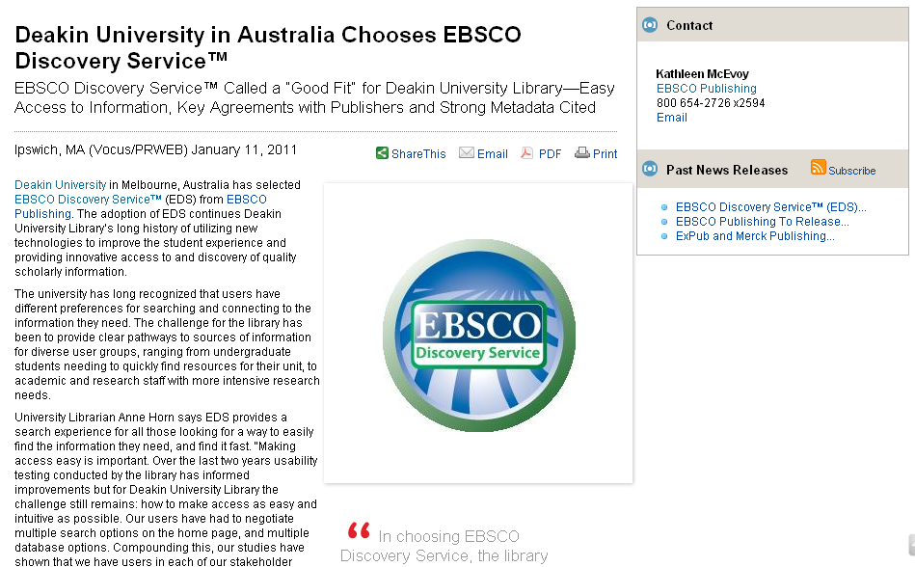
Open source publishers:
HathiTrust
OAIster
+ metadata and full text of 1000s of others including :
Informit
Alexander Street Press
JSTOR
Newsbank
ScienceDirect
Web of Science
Sage
American Chemical Society
American Medical Association
American Meteorological Society
BioMed Central
Blackwell
BMJ
Brill Academic Publishers
Cambridge University Press (CUP)
CSIRO Publishing
Directory of Open Access Journals
Duke University Press
Edinburgh University Press
Elsevier
Emerald
Highwire Press
IEEE
IOS Press
KluwerLaw International
Lippincott Williams & Wilkins (LWW)
MIT Press
Nature Publishing Group
Oxford University Press
Palgrave Macmillan
PubMed Central
SAGE
Springer (includes full text searching)
Taylor & Francis
Informa
University of Queensland Press
Wiley
World Scientific Publishing Company
… plus more!
Deakin + EBSCO = “Good fit”
65 EBSCO subscriptions
99,000 journals
Quality metadata
Publisher partners
Relevancy ranking
Full text searching
Notes:
We know the shortcomings of Encore
It’s not a single integrated index
It’s not web scale
We wanted to explore this options
So in January this year we introduced EBSCO Discovery Service to our users
[click]
EDS felt like a good fit for us on a number of levels
We are also a big EBSCO subscriber
Impressed with agreements they’ve made to obtain metadata and the ability to search the full text of key leading publishers

Slide 21
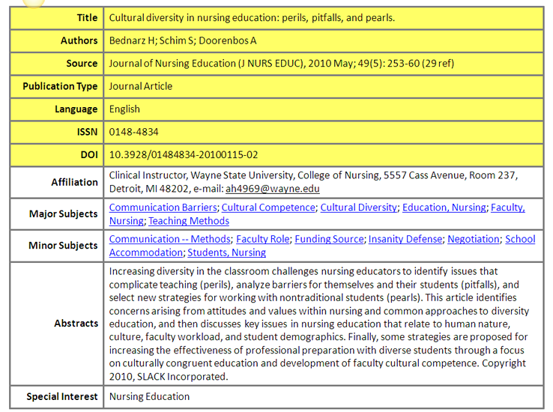
Metadata quality
Thin metadata
Thick metadata
CRICOS provider code: 00113B
Notes:
We were also impressed by the quality of the metadata offered by EBSCO
EBSCO talk quite a bit about the differences between thin and thick metadata
Thin metadata includes just the bare essentials needed to describe the resource – title, author, source information
Thick metadata which includes Subject information and Abstracts, allows better discovery from the user’s point of view
EBSCO actively work to improve the metadata quality of its owned resources by employing paraprofessionals to do hand coding
This has an impact on search results

Slide 22
CRICOS provider code: 00113B
Notes:
This is an interesting graph depicting some sample searching that compared some searches across Primo, Summon and EDS
It’s meant to demonstrate the difference in the number of records returned as a result of the quality of the metadata of the records
I did do a similar search here across Australian sites, and got similar results
So EDS demonstrates a better return because of the ability to mine the thick metadata

Slide 23
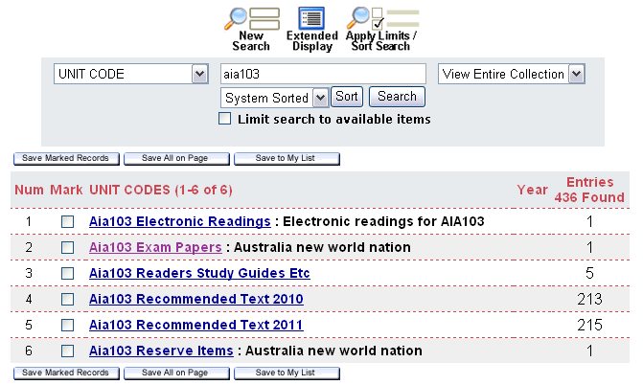
Search options on Library home page
CRICOS provider code: 00113B
Notes:
How have we presented these two interfaces?
Quick Search and Discover More
QS being Encore
DS more invites users to do more in depth research
Problem = we still need to offer other choices
Most libraries have this problem where their discovery layer doesn’t actually discovery everything
Rely on Classic catalogue for some functionality such as finding unit material and our A-Z journal and database listing
Like most other libraries, the proportion of the budget spent on e-resources has increased spectacularly over recent years – in 2011 92% of our serials budget is spent on e-journals; 44% of our book budget is used to purchase e-books

Slide 24
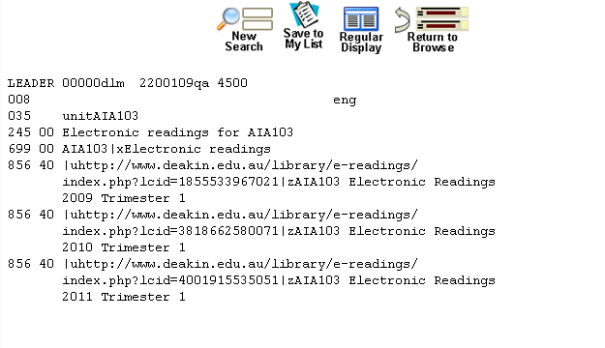
CRICOS provider code: 00113B

Slide 25
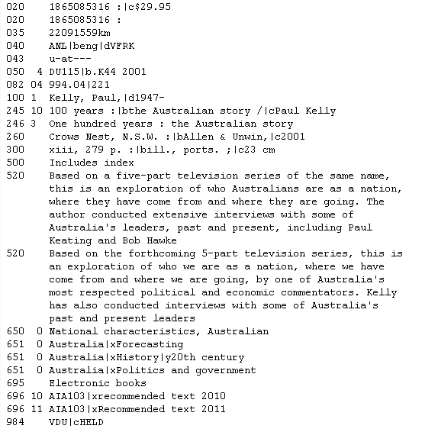
CRICOS provider code: 00113B

Slide 26
CRICOS provider code: 00113B
Notes:
Discovery layers have been implemented now for a couple of years
What do our users think?
Are they really as happy and thrilled as this photo suggests?

Slide 27
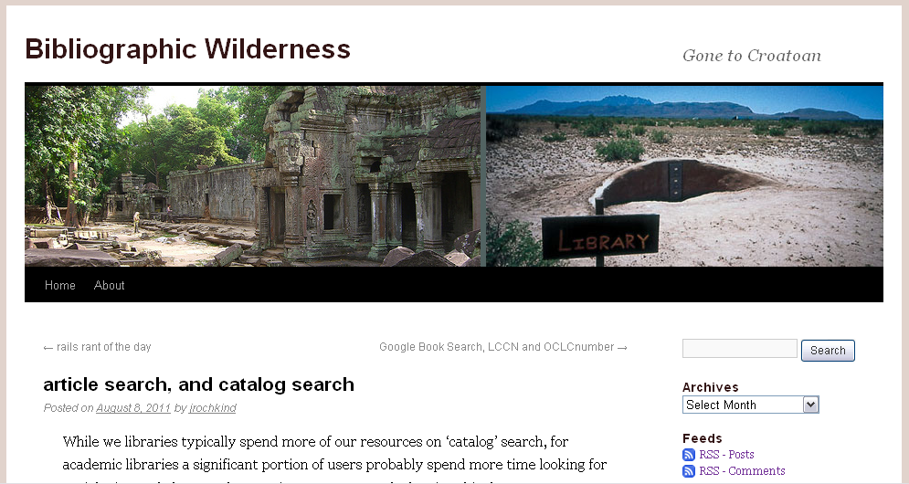
“Interesting research from UVa suggests that users may not want actual merged search results, [and] may indeed specifically prefer not to have it [one merged result list] it”
“Really important point that came out in our user testing is that patrons _did not_ want blended results. At all. Across the board dissatisfaction with that approach”
“Patrons come to Virgo knowing the type of item they’re looking for (e.g. book or article), and too much info in search results is not desired”
CRICOS provider code: 00113B
Notes:
This is a blog I came across recently – interesting because I don’t think there’s been that much critical literature yet on what users think of discovery layers
In August of this year Jonathan Rochkind raised the issue of combined article and catalogue search
[click] He challenges the assumption that the way to provide access to articles is via a single search interface that would search the catalogue and scholarly articles then present the results in one merged result list.
Jonathan writes about a University of Virginia usability test.
[click] Julie Meloni found that a “Really important point that came out in our user testing is that patrons _did not_ want blended results. At all. Across the board dissatisfaction with that approach.”
[click] She also writes that “patrons come to Virgo knowing the type of item they’re looking for (e.g. book or article), and
Too much info in search results is not desired.”

Slide 28
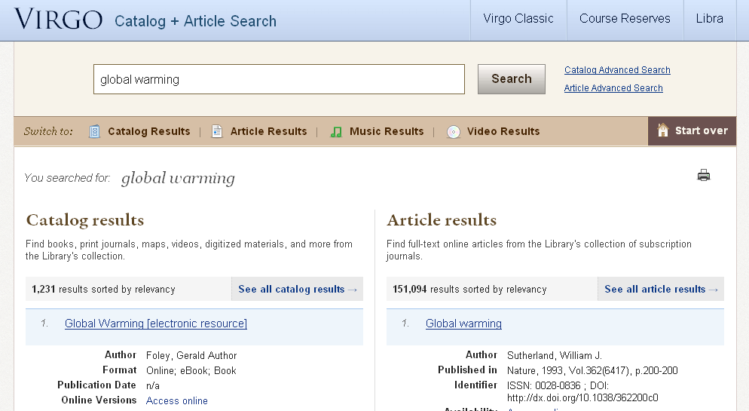
CRICOS provider code: 00113B
Notes:
This is the University of Virginia’s current approach
Julie writes that [click]
We know that the future is electronic
In 2011 92% of our serials budget was spent on e-journals, and nearly half our book budget was used to purchase e-books
The power of full text searching means that content
We don’t know if Deakin users are like the University of Virginia users
We do know that some of them are still drawn to the concept of the catalogue and a good many are still looking for known books and journals

Slide 29
CRICOS provider code: 00113B
Notes:
Interesting development
EBSCO / III partnership
will allow EDS via Encore
- This could mean for us that we would replace the default EBSCO mashup of databases with the EDS database

Slide 30
Next steps for Deakin?
CRICOS provider code: 00113B
Notes:
We will experiment with offering EDS via the Encore interface
There is a lot more work we can do to tailor our EDS interface
We will consult our users and do some usability testing
We will explore the concept of offering ‘beginner’ and ‘advanced’ interfaces
We need to lead our users but at the same time listen to them so we know what their needs are
Need to be agile and come up with solutions in a quickly evolving environment

Slide 31
Questions?
Michelle Watson
Email: michelle.watson@deakin.edu.au
Phone: 03 5227 8220
CRICOS provider code: 00113B

