Slide 1
WORKS AND EXPRESSIONS “IN VERREM”

Slide 2
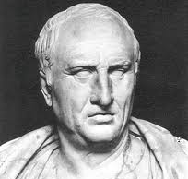
This is Marcus Tullius Cicero
His attributes are: Born 106 B.C., died 43 B.C.
Politician, orator, barrister, author (374); male (375); Rome (370), lat; grc (375)

Slide 3
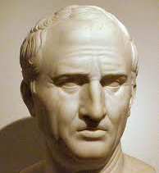
WORK
Cicero, Marcus Tullius. In Verrem.

Slide 4
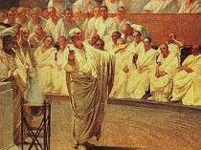
Expression (1)
Latin, spoken word, gestures

Slide 5
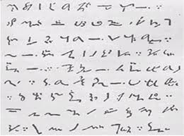
Expression (2)
Text (short-hand, devised by Cicero’s slave, later freedman, Tiro), Latin

Slide 6
Expression (3)
Fair copy circulated in standard Latin

Slide 7
Expression (4)
German text
Cicero, Marcus Tullius. In Verrem. German

Slide 8
Expression (5)
Latin text; parallel English text
Cicero, Marcus Tullius. In Verrem. Latin
Cicero, Marcus Tullius. In Verrem. English

